Slide 1

Homesite Quote Conversion
By Anthony Fiel
Data Science Remote – DATR 406 – Final Project

Slide 2
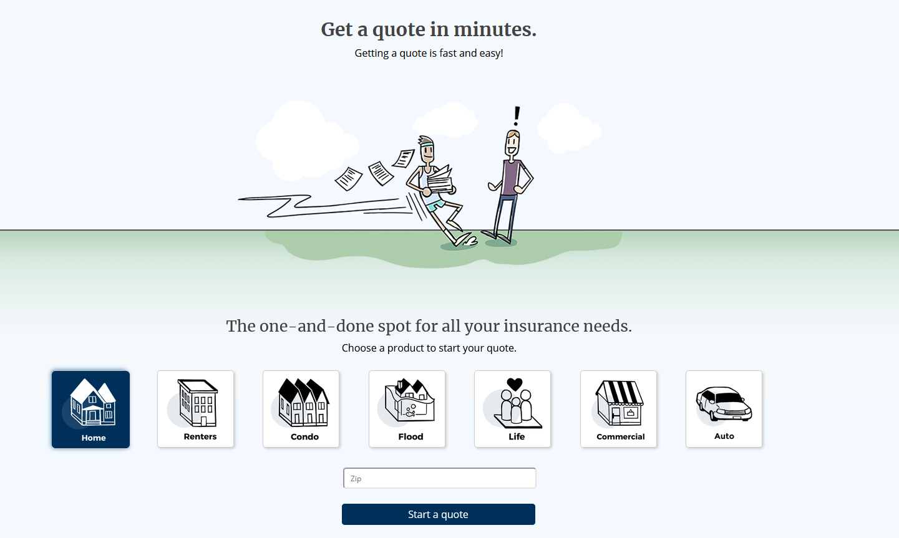
Problem Description
In order to help understand the impact of proposed pricing changes and maintain an ideal portfolio of customer segments, we need to predict which customers will purchase a given quote.

Slide 3
Data and Assumptions
This analysis has been done using an anonymized feature-set, so I will be making a few assumptions of the given dataset.
The given metrics are all classified with the following prefixes:
Sales – Pricing (premiums and deductibles)
Personal – Information about the customer
Property – The asset in question of being insured
Geographic – location information (customer/asset)
Coverage – coverages offered
General (Not Specified)
Missing values will be imputed with most common value
In the current world, quoting is made under the assumption that the highest drivers are monthly premium, deductible, and coverages. So we will assume that our model and analysis will reflect this.

Slide 4



Model Comparison
K-Nearest Neighbors
Random Forest
Random Forest (limited features)
 |  | Actual
 |  | Did not Convert | Converted
Predicted | Did not Convert | 39859 | 2625
 | Converted | 5057 | 4610
 |  | Actual
 |  | Did not Convert | Converted
Predicted | Did not Convert | 41420 | 1064
 | Converted | 3905 | 5762
 |  | Actual
 |  | Did not Convert | Converted
Predicted | Did not Convert | 41428 | 1056
 | Converted | 3542 | 6125
Precision: 0.6372
Recall: 0.4769
Accuracy: 0.8527
Precision: 0.8441
Recall: 0.5960
Accuracy: 0.9047
Precision: 0.8529
Recall: 0.6336
Accuracy: 0.9118
Baseline Accuracy: 0.8146
Note: precision can be thought of as "how useful the results are“ and recall is "how complete the results are"

Slide 5
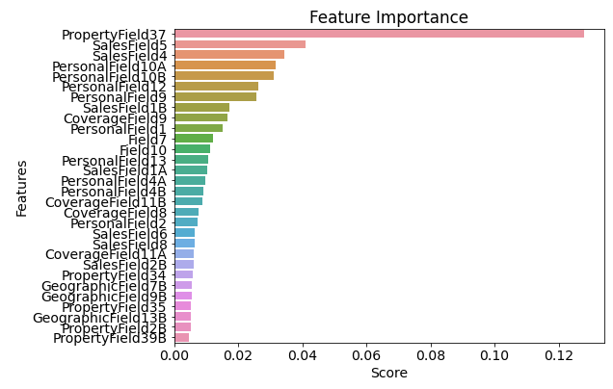
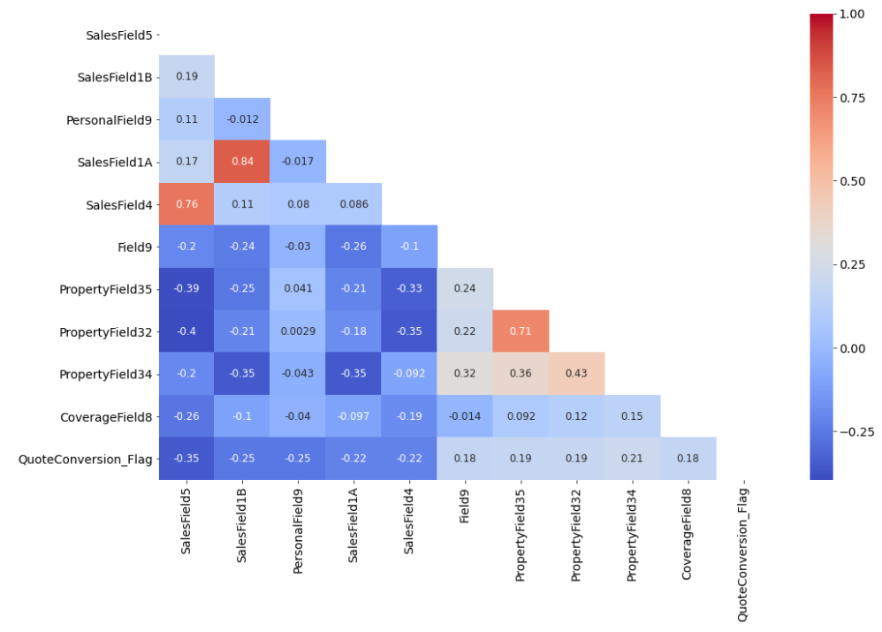
Feature Analysis
Most Correlated fields to quote conversion
SalesField5 | -0.35034
SalesField1B | -0.25335
PersonalField9 | -0.25205
SalesField1A | -0.21763
SalesField4 | -0.21737
CoverageField8 | 0.178042
Field9 | 0.179569
PropertyField35 | 0.187117
PropertyField32 | 0.192496
PropertyField34 | 0.213861

Slide 6
Recommendation
Because the feature set given has been anonymized, we can only make assumptions on the categories. From the correlation heatmap we see that the Sales and Property categories are the most important. And from the random forest feature importance chart we see that Property, Sales, and Personal are the driving factors.
The recommendation here would then be to either develop or tune the pricing model for products. Since sales represents pricing/premium, and property is the asset being insured. This supports our initial assumption that pricing has a big affect on quote conversion.

Slide 7

Questions/Comments

